Slide 1
TELCO CUSTOMER CHURN
PRESENTER: Mawusi Angel
DATE: 12/01/2020

Slide 2

MOTIVATION
Customer churn is when a customer decides to stop using products or services from a company. Churn rate is the percent of subscribers that have canceled within a certain period. In this analysis problem of churning is addressed and data factors affecting the churn are analyzed for their effect on the rate.
The aim is to "Predict behavior to retain customers. Customer churn is one of the biggest fears of any industry. From various studies in the past, it is known that the cost of acquiring a new customer has been far greater than retaining one. The goal is to analyze all relevant customer data and develop focused customer retention programs, to help boost companies' revenue
In today’s fast-paced world, mobile phone customers have many choices and can easily switch between service providers. Improving customer attrition rates and enhancing a customer’s experience are valuable ways to reduce customer acquisition costs and maintain a high-quality service.

Slide 3
QUESTIONS
1.Among gender, partner, dependents, phone services, internet services, contract and payment methods which variable affects churn rate the most.
2.For Subscribed customers, how long did they usually stay with the company i.e. tenure rate.
3.For subscribers paying for services, what portion of these customers using phone services with multiple lines and by how much it influences customers decision to stay.

Slide 4
DATA
Each row represents a customer, each column contains customer’s attributes described on the column Metadata.
The data set includes information about:
Customers who left within the last month – the column is called Churn
Services that each customer has signed up for – phone, multiple lines, internet, online security, online backup, device protection, tech support, and streaming TV and movies
Customer account information – how long they’ve been a customer, contract, payment method, paperless billing, monthly charges, and total charges
Demographic info about customers – gender, age range, and if they have partners and dependents

Slide 5
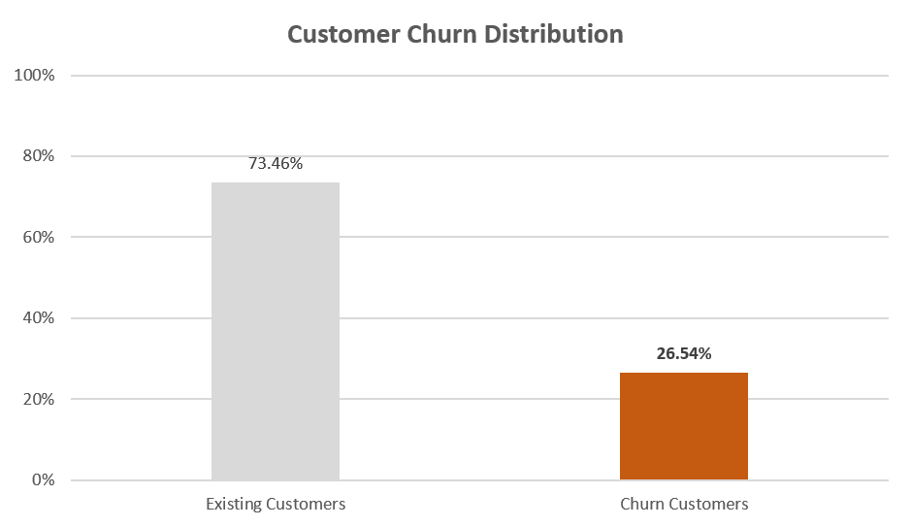
CUSTOMER CHURN DISTRIBUTION
Analysis shows that Churn rate of the Telecom company is around 26%.

Slide 6
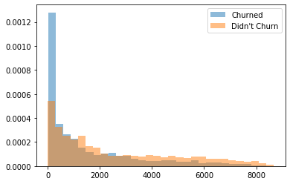
CHURN BY TOTAL CHARGES
The chart shows that the higher the total charges made to a customer, the lower the churn rate
Customers who didn’t churn had more Total Charges

Slide 7
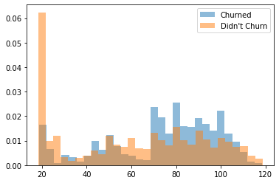
CHRUN BY MONTHLY CHARGES
Customers who churned seemed to be more likely to pay higher monthly charges, and customers who didn’t churn where more likely to be paying the least per month.

Slide 8
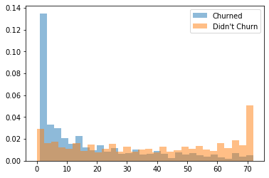
CHURN BY TENURE
The first few months of tenure between months 1-10 seem to be critical, as this is when most of the churn is happening while quite a many are there for about 72 months. Customers who do not churn tend to stay for a longer tenure. The chart shows that churn rate decreases as tenure increases, which is a good indication that the company is able to keep long-time clients.

Slide 9
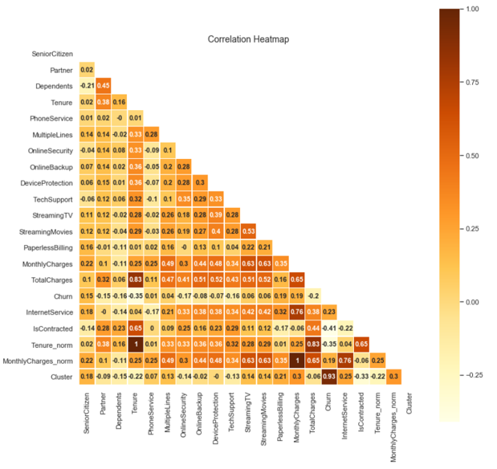
CORRELATION BETWEEN FEATURES
From correlation matrix, features like Tenure, Monthly charges and Total charges are highly correlated with services like Multiple Phone Lines services and Internet services like Online Security, Online Backup, Device Protection, Tech Support, Streaming TV and Streaming Movies services.

Slide 10
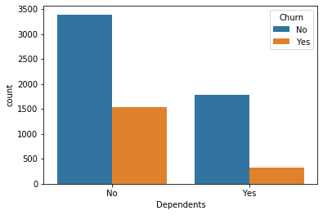
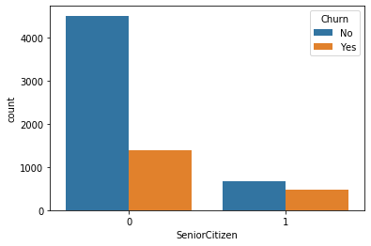
CHURN BY DEMOGRAPHICS
Customers with dependents are more likely to churn.
Senior citizens are more likely to churn

Slide 11
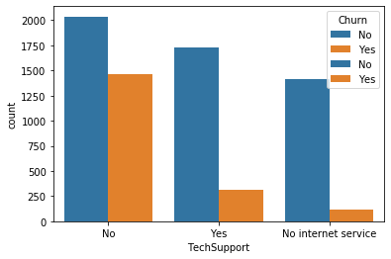
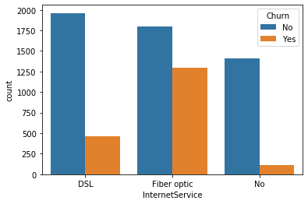
CHURN BY SERVICES PROVIDED
Customers who require tech support are more likely to be retained. Customers who do not require tech support churn, Telco should ensure customers get more tech support.
Fiber Optics have higher churning rate than DSL for clients who have internet services. While fiber optic, have higher churn rate, they also deliver higher total charges, hence a better investigation on why clients aren’t satisfied with fiber optic is important.

Slide 12
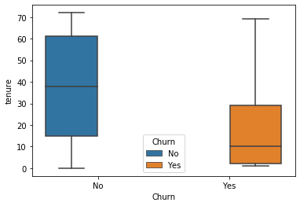
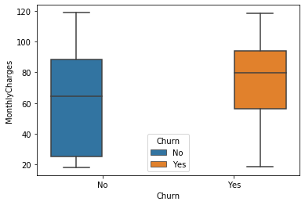
MEDIAN TENURE
It can be deduced that most customers who churn have high monthly charges, with median monthly charges above 75
From the chart above it can concluded that the customer who churn have low tenure rate with a median of 10

Slide 13
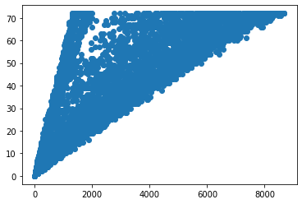
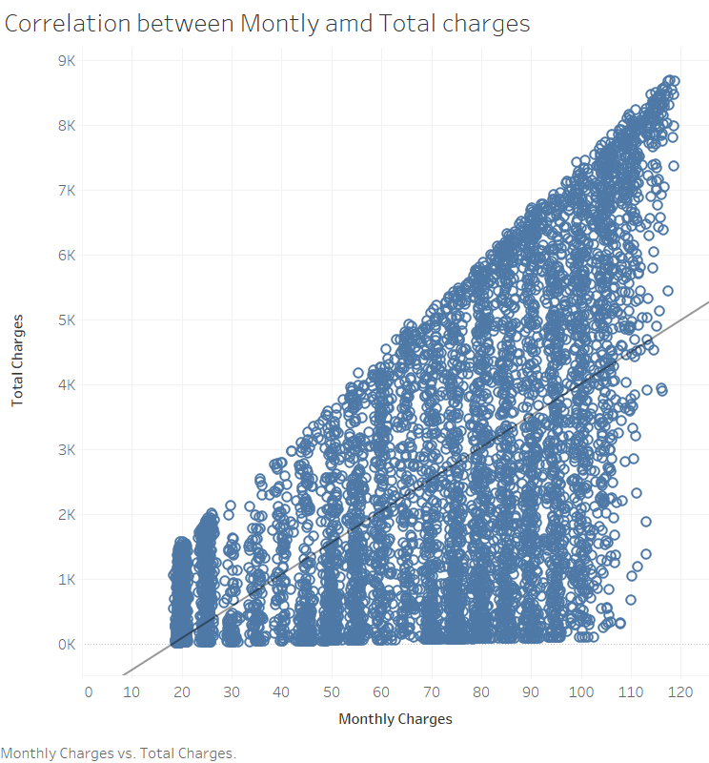
CORRELATION
Total charges and tenure are highly correlated
Total charges increases as monthly customer bill increases indicating a positive correlation between total charges and monthly charges

Slide 14
CONCLUTION
Although there are many reasons for customer churn, some of the major reasons are service dissatisfaction, costly subscription, and better alternatives Features such as gender, phone services, multiple lines do not really have much effect on churn.
Lastly, total charges, monthly contracts, fibre optic internet services and seniority can lead to higher churn rates. This is interesting because although fibre optic services are faster, customers are likely to churn because of it. I think we need to explore more to better understand why this is happening
A lot of customers have been with the telecom company for just a month, while quite a many are there for about 72 months. This could be potentially because different customers have different contracts. Thus based on the contract they are into it could be more/less easier for the customers to stay/leave the telecom company
Having DSL internet services also reduces the probability of churn.

